Slide 1
Outsiders Presentation
Sodapop
Group 1
Nathan, Maddie, Adriyana

Slide 2
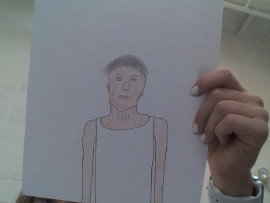
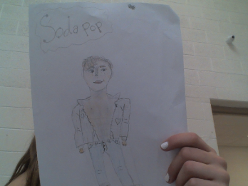
This is what SodaPop Looks like:

Slide 3
Here are the important information about Sodapop:
Sodapop is Ponyboy’s favorite brother. He is 16-almost-17 years old and NEVER cracks a book. He is sweet and charming and overall one of the most understanding characters in the book.

Slide 4
Here are some Sodapop physical traits:
Sodapop has bright blue eyes. He has greasy shaggedy brown hair. Sodapop is one of the stylish characters and has a charming personality.

Slide 5
Last but not least here are the character traits of Sodapop:
He is always happy and understanding. He never yells at anyone. Sodapop wouldn’t hurt a fly. He is gentle and understanding and is there for almost anybody.

Slide 6
As you can see...
We all have learned new and different things about sodapop. He is a wonderful character in the book and is one of the kindest characters. He is there for Ponyboy when Darry cant be or doesn’t want to be. Sodapop is not as hard on Ponyboy as Darry either. Overall Sodapop is a great character in this book.

